Slide 1
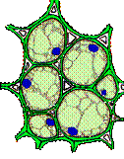
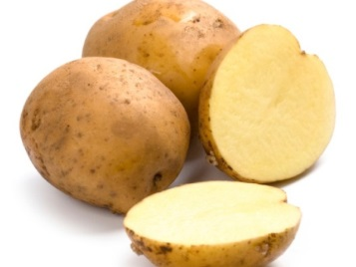
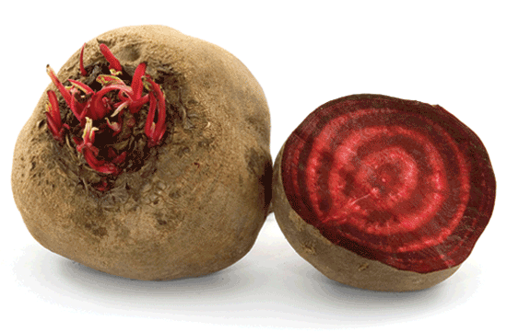
Simple permanent tissue
It is made up of one type of cells.
Depending upon the functions it performs, It is classified as follows :
Intercellular spaces
Nucleus
i. Parenchyma:
Its cells form basic packing tissue.
The cells are living, possess nucleus, are thin walled and unspecialised.
They are loosely packed, and therefore form intercellular spaces.
This tissue stores food as in potato, beet root etc.
Spaces between the cells

Slide 2
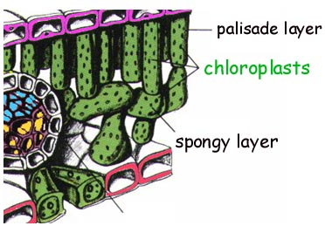
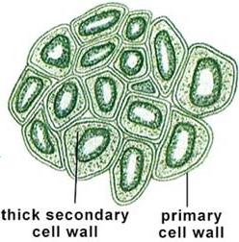
Simple permanent tissue
ii. Chlorenchyma :
The parenchyma in the leaf contains chloroplast. Hence this tissue is called chlorenchyma.
It perform the function of photosynthesis.

Slide 3
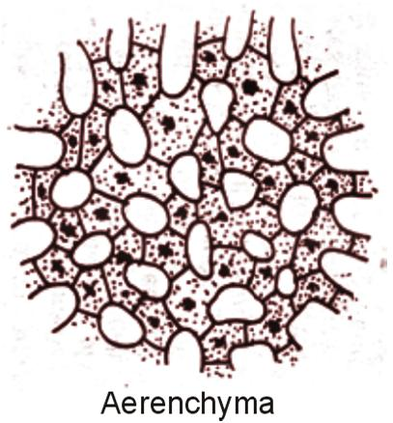

Simple permanent tissue
iii. Aerenchyma :
In aquatic plants the intercellular spaces form large air cavities.
They give buoyancy to the plant and help them float in water.
Such parenchyma is called aerenchyma.
The force to float
Air cavity

